Slide 1
KONGSBERG MARITIME PRESENTATION
FOR
UNITED ARAB SHIPPING COMPANY (UASC)
DUBAI OCTOBER 29.2014

Slide 2
KONGSBERG
Kongsberg attendents :
Mr. Stein Dahle,
Snr. Project Manager and in lead of UASC Newbuildings Project HHI
Mr. Leif Kristian Weum
Vice President, Sales Merchant Marine
Mr. David Wilson,
Managing Director, Kongsberg Maritime Dubai
Mr. Edmond D’Souza
Service Manager Automation, Kongsberg Maritime Dubai
Mr. Sreenah Nair
Service Manager Navigation, Kongsberg Maritime Dubai
,

Slide 3
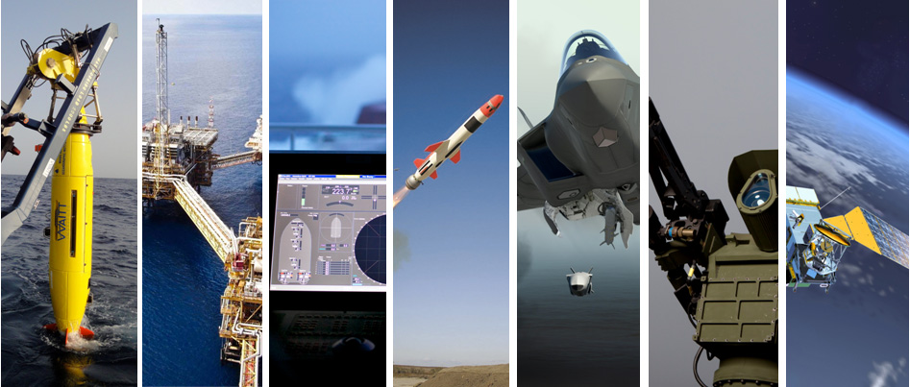
KONGSBERG High-Tech solutions, from deep sea to outer space
Advanced solutions and applications for the maritime, oil & gas, defence and space industry.
- Extreme Performance for Extreme Conditions -

Slide 4
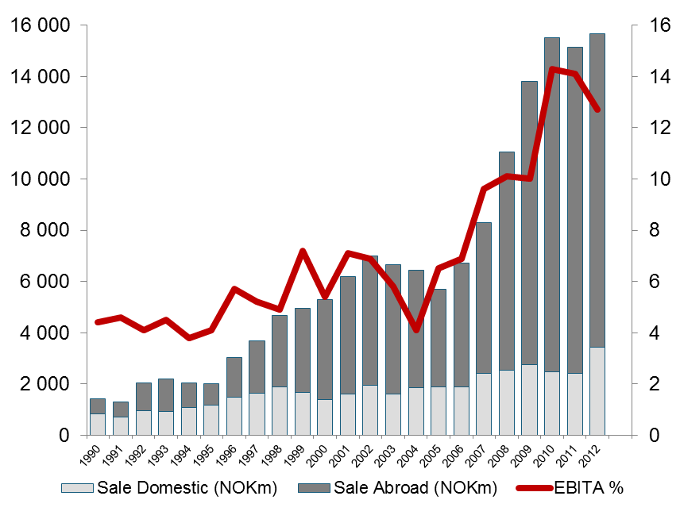
KONGSBERG
REVENUES AND EBITA MARGIN 1990 - 2012
Global Top 3
Maritime
Defence
Subsea
Space
Company data (2012 figures)
7 295 employees
78 % revenues from outside Norway
Located in more than 25 countries

Slide 5
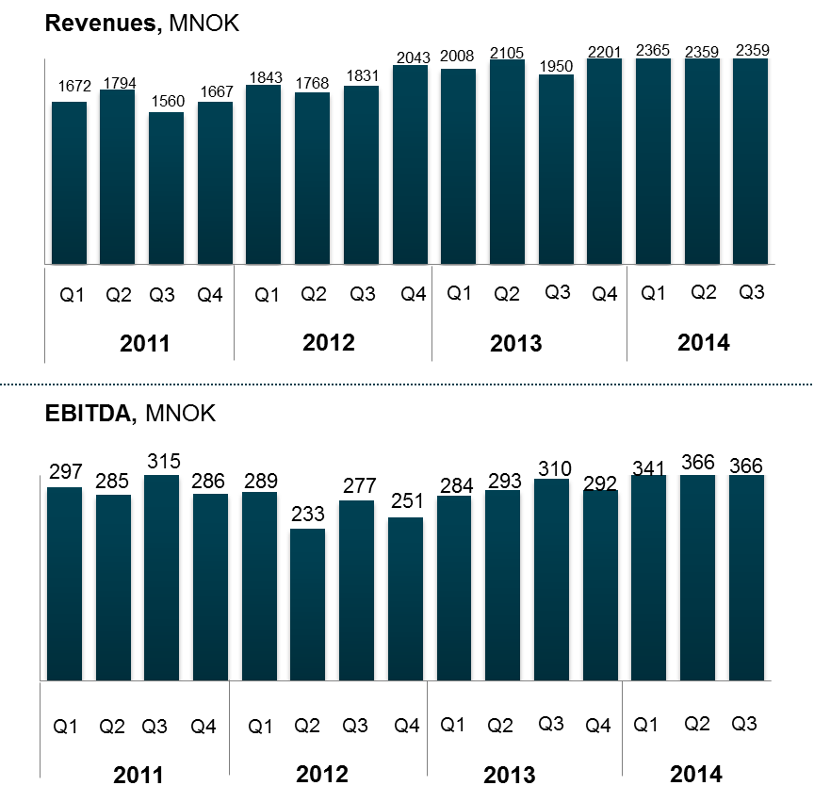
Increased marked shares drives growth in revenues
Key revenue and EBITDA drivers
Premium market position and increased market shares in all core segments
Increased market shares for the merchant marine within the gas tankers , the product tankers and the container segments.
Increased market shares and continuous growth in standard OSV market.
Growth in the subsea market, fueling our system deliveries for under water navigation and under water vehicles (AUV)

Slide 6
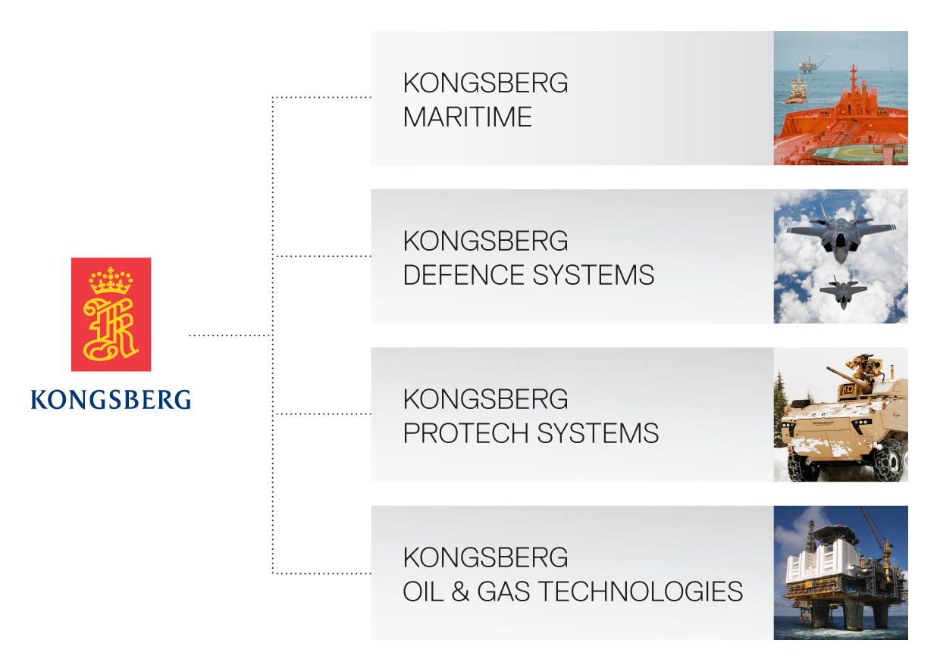
KONGSBERG
The KONGSBERG organisation

Slide 7

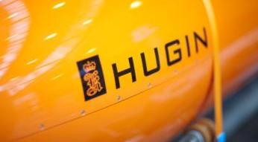
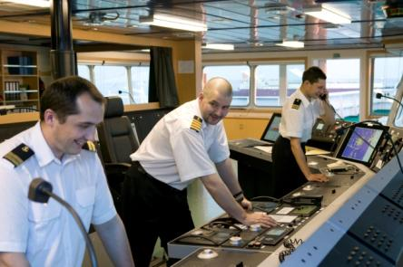
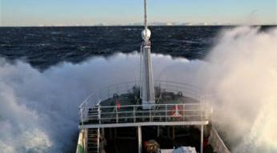
Kongsberg Maritime
Offshore – Merchant Marine – Subsea
55 offices in 18 countries
4.258 employees
Revenues MNOK 1.272 bill USD (2013)
Number of vessels in operation 15,000
Positioning, Navigation, Automation, Propulsion Control, Performance Monitoring, Simulation, Seabed Surveying and Fishery Systems

Slide 8
Kongsberg Maritime
PRESIDENT
SALES, MARKETING INT. OPERATIONS
SUBSEA
MERCHANT MARINE
CUSTOMER SUPPORT & TRAINING
OFFSHORE
WORLD CLASS - through people, technology and dedication.

Slide 9
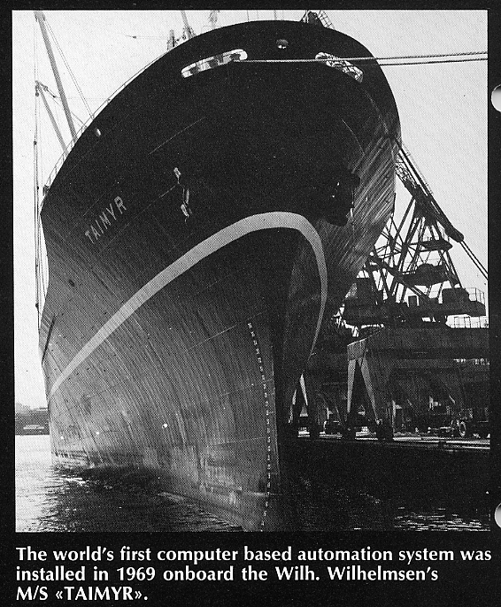
Kongsberg Maritime
Pioneers in integrated ship automation
Wilh.Wilhelmsen Liner M/S TAIMYR
World first computer based integrated automation system installed 1969
Control & monitoring system for UMS
Anti collision radar system (ARPA)
Propulsion cntrol system (bridge control)
Fully automatic power management system
Condition based monitoring
Load calculator with stabillity calculation.
Administrative funcitonallity
Notes:
Taimyr var verdens første handelskip med en datamaskin om bord.
Funkskjonene er de mye av de samme som man finner på et moderne skip.
Skipet hadde Norsk Datamaskin – NOR1 fra Norsk Data (og var Norsk Data’s første leveranse).
Det ble søkt om 1,6 millioner i forskningsmidler for å gjennomføre prosjektet. Når prosjektet var ferdig var prislappen over 4 millioner. Hadde det vært søkt om så mye penger fra starten av, hadde nok ikke dette prosjektet blitt en realitet.
Og da hadde nok ikke jeg stått her idag.
Utstyret fra Taimyr står i dag på sjøfartsmuseet i Oslo.

Slide 10
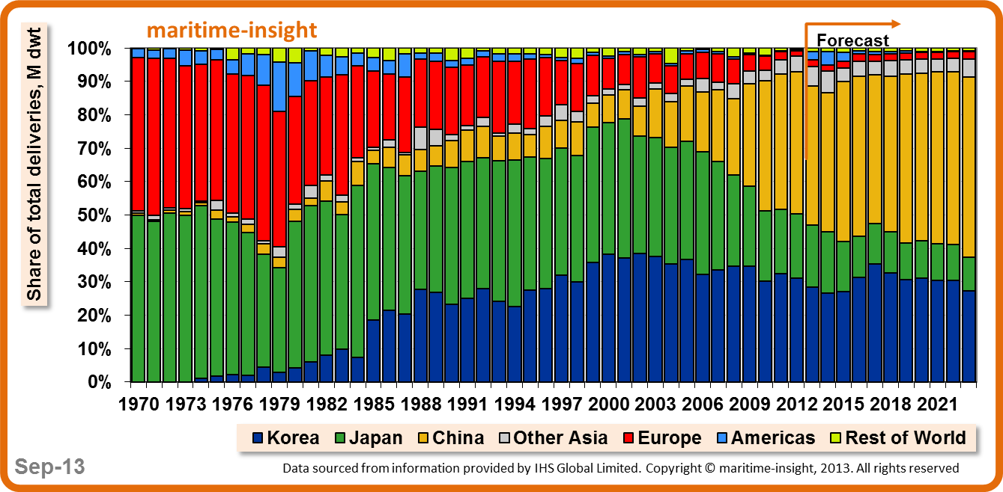
The word market, total deliveries in dwt
Kongsberg Maritime

Slide 11
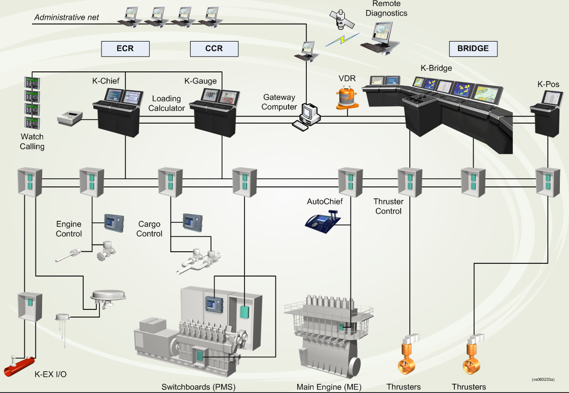
Kongsberg Maritime

Slide 12
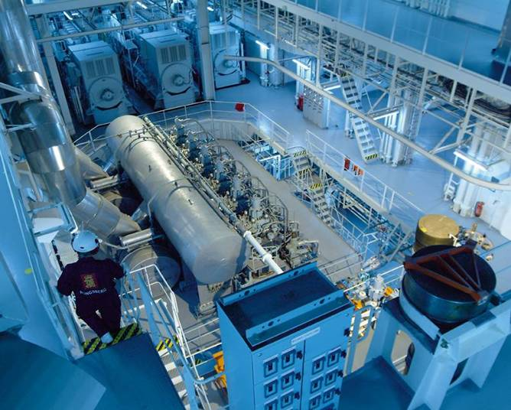
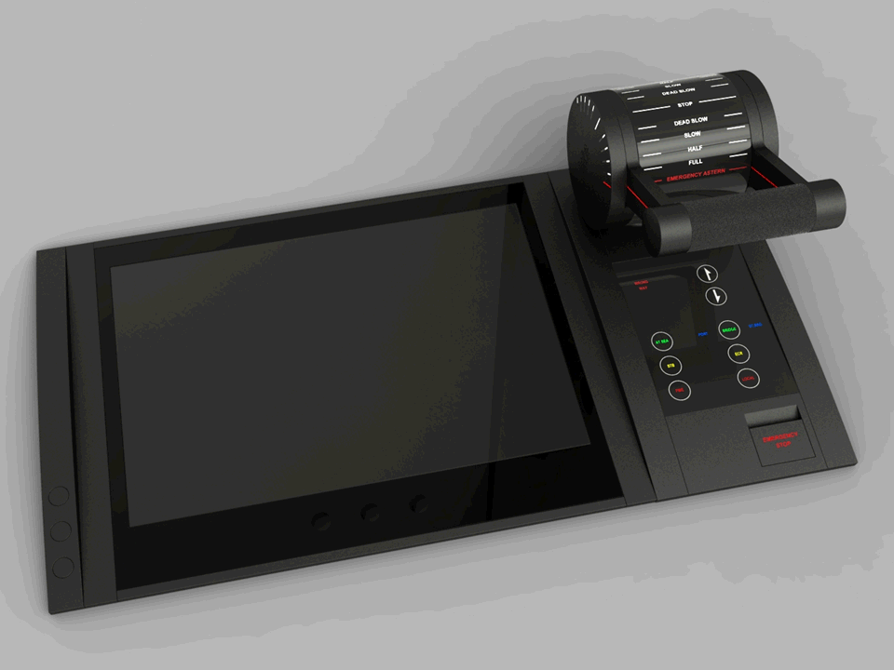
Kongsberg Maritime
Control Systems for Propulsion
WORLD CLASS – through people, technology and dedication

Slide 13
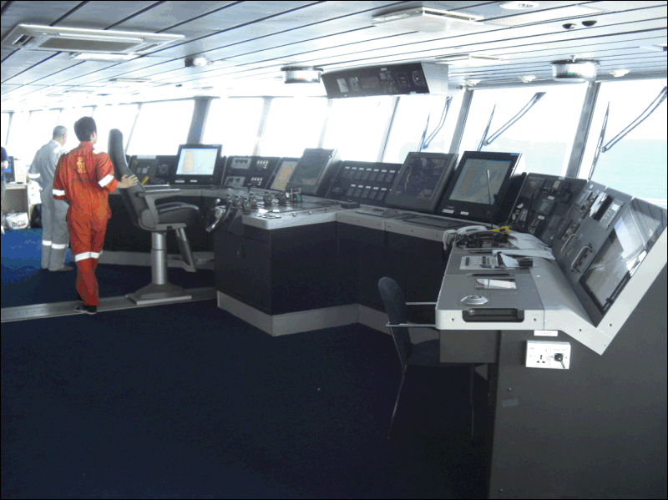
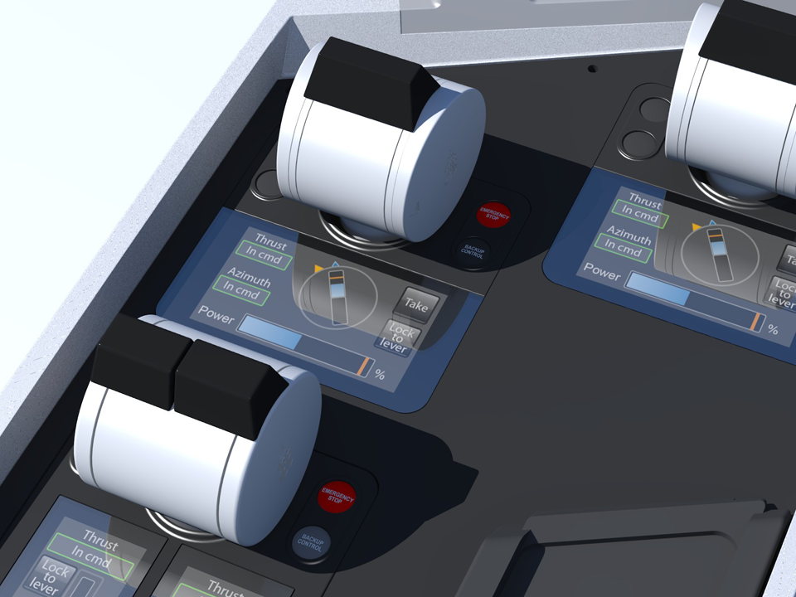
Kongsberg Maritime
Integrated Navigation Systems

Slide 14

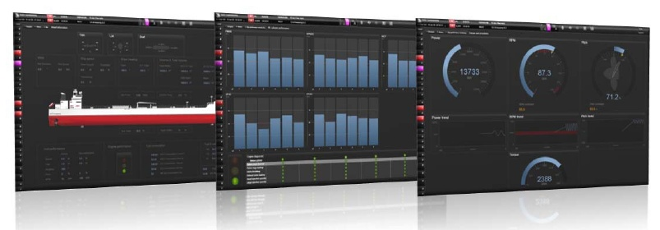
Kongsberg Maritime
Integrated Automation Systems
Engine Room and Cargo Plants

Slide 15

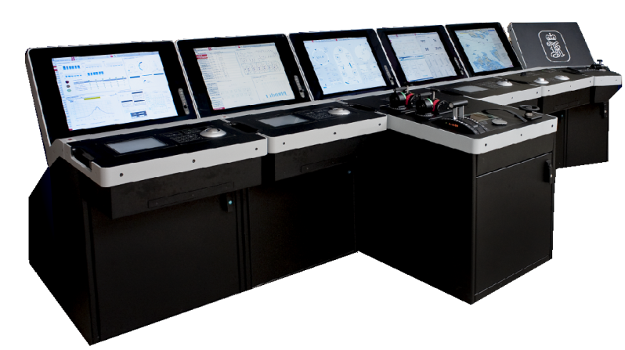
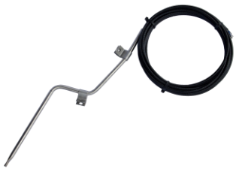
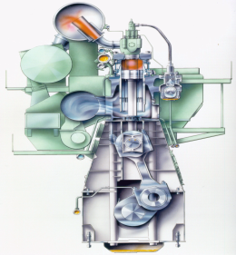
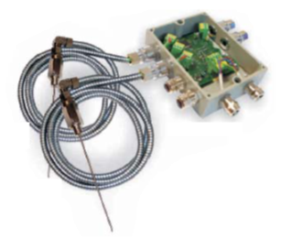
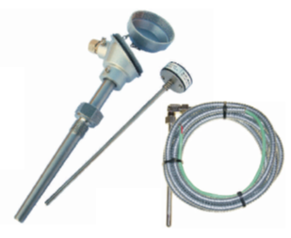
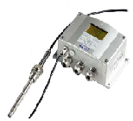
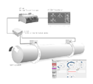
Kongsberg Maritime
Machinery Instrumentation
BEARING TEMP.
MONITORING
BEARING WEAR
MONITORING

Slide 16
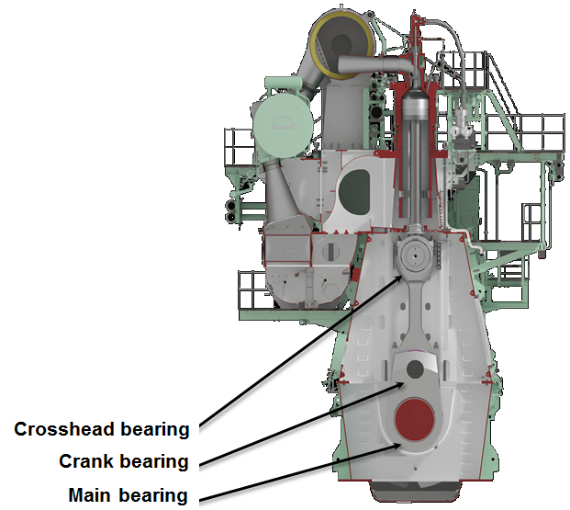
Kongsberg Maritime
Bearing Wear Monitoring System
Monitors the actual combined wear of the main- crank- and crosshead bearings
Measures how far down the crosshead guide shoe goes in BDC
More than 1500 systems sold
Recommended for MAN engines

Slide 17
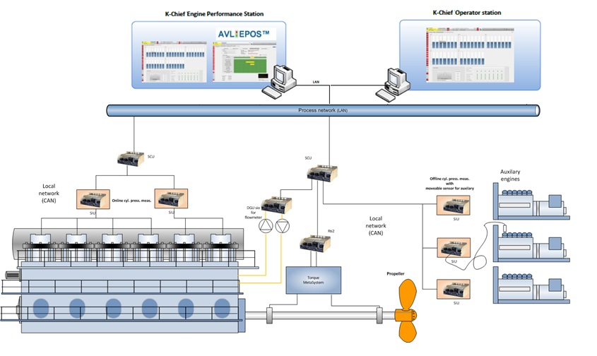
Kongsberg Maritime
Engine Performance Monitoring

Slide 18
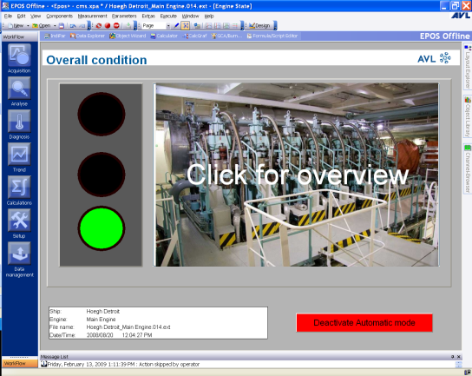
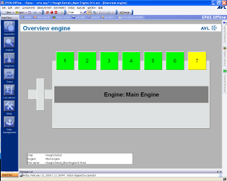
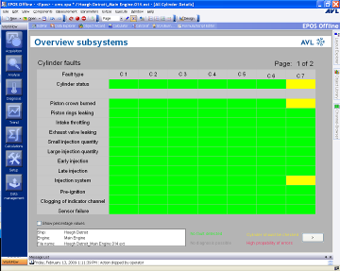
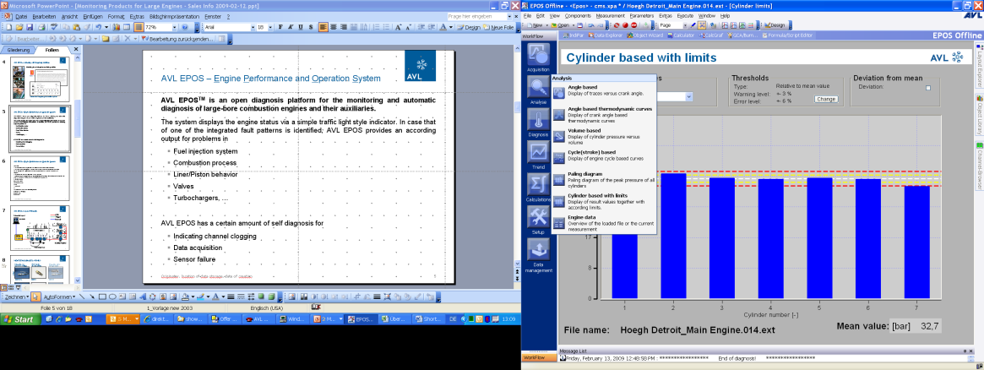
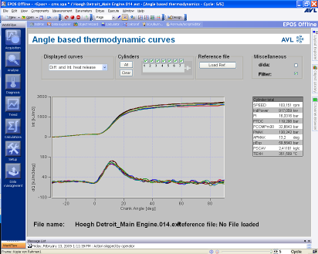
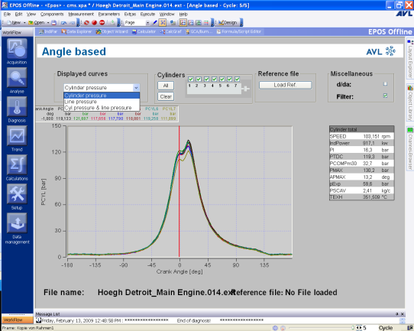
Kongsberg Maritime Engine Performance Monitoring
Key benefits of this system may include:
On-line engine monitoring and diagnosis
Cylinder load balance monitoring
Calculation of CO2, NOX and SOX
Increase engine performance
Reduce maintenance costs
Minimizing risk for engine damage

Slide 19
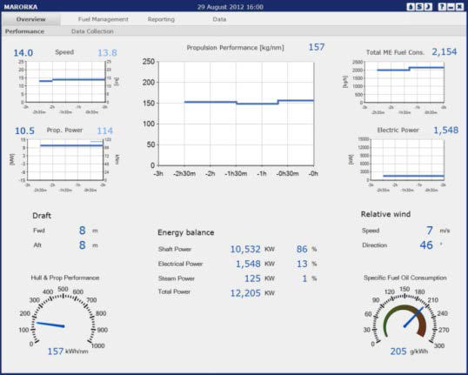
Kongsberg Maritime Energy Management with Marorka
The Overview module provides a performance overview with all key performance indicators

Slide 20
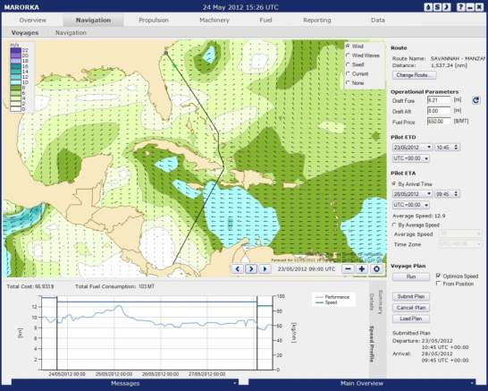
Kongsberg Maritime Energy Management with Marorka
The Voyages module assists in effective voyage planning.
Using a simulation model, it identifies the speed profile that results in minimized voyage costs for a given route, ETD and ETA.

Slide 21
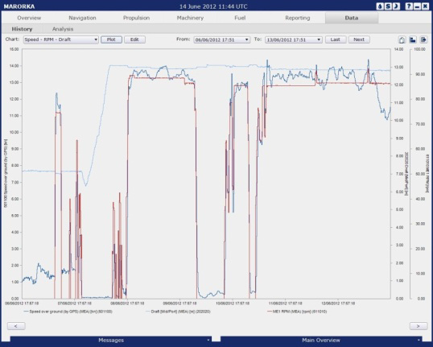
Kongsberg Maritime Energy Management with Marorka
The History module is designed to visualize how the numerous ship operational parameters affect fuel efficiency.
Graphical trending of operational values over a period of time is displayed, thus helping the crew locate focus areas for improving energy efficiency and fuel savings.

Slide 22
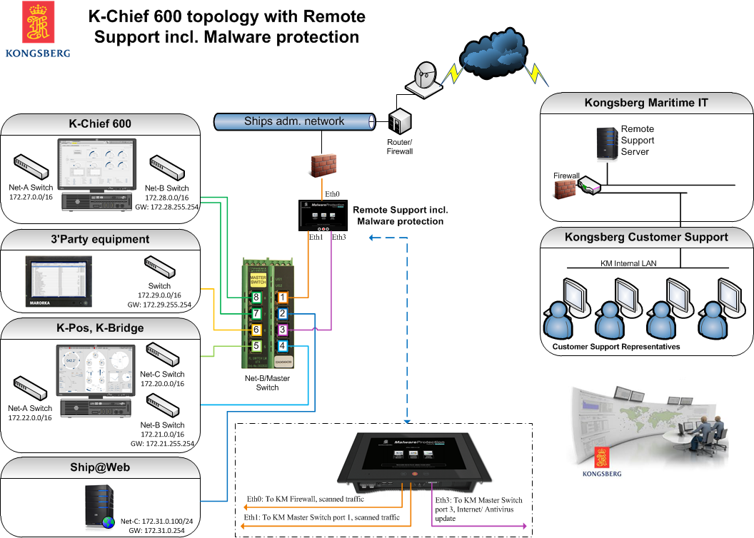
Ship@Web Remote Support Topologi
Kongsberg Maritime

Slide 23
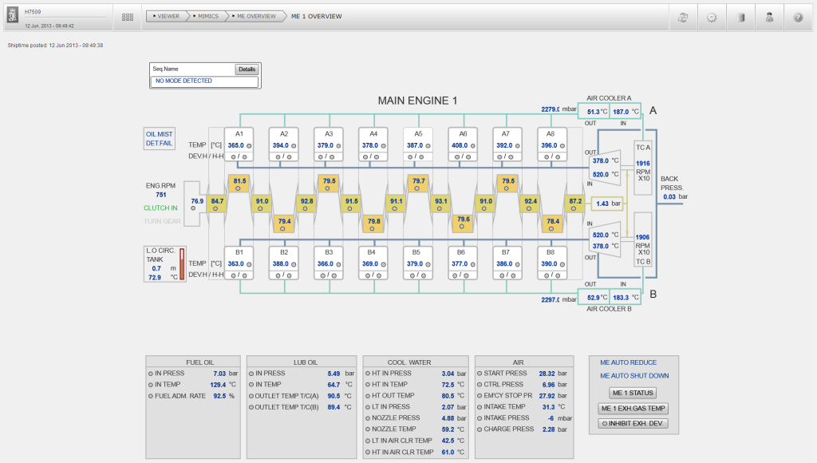
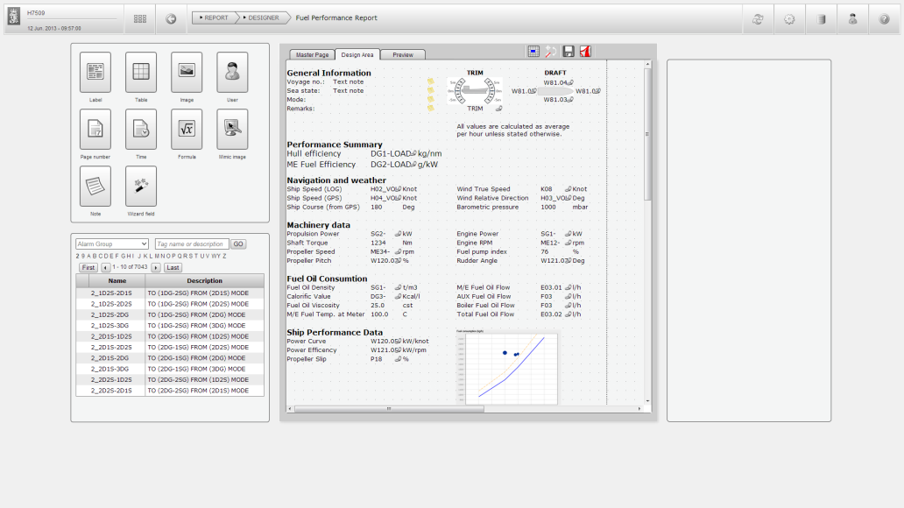
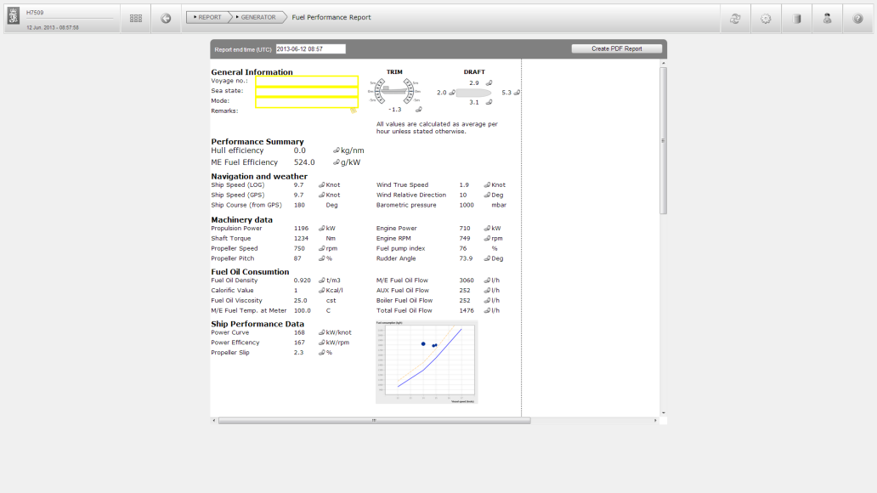
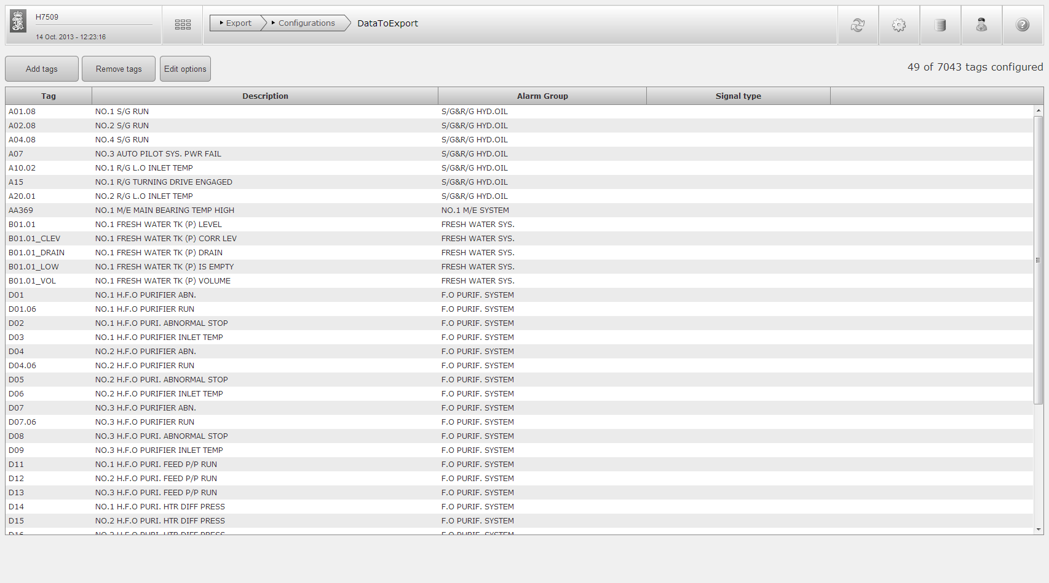
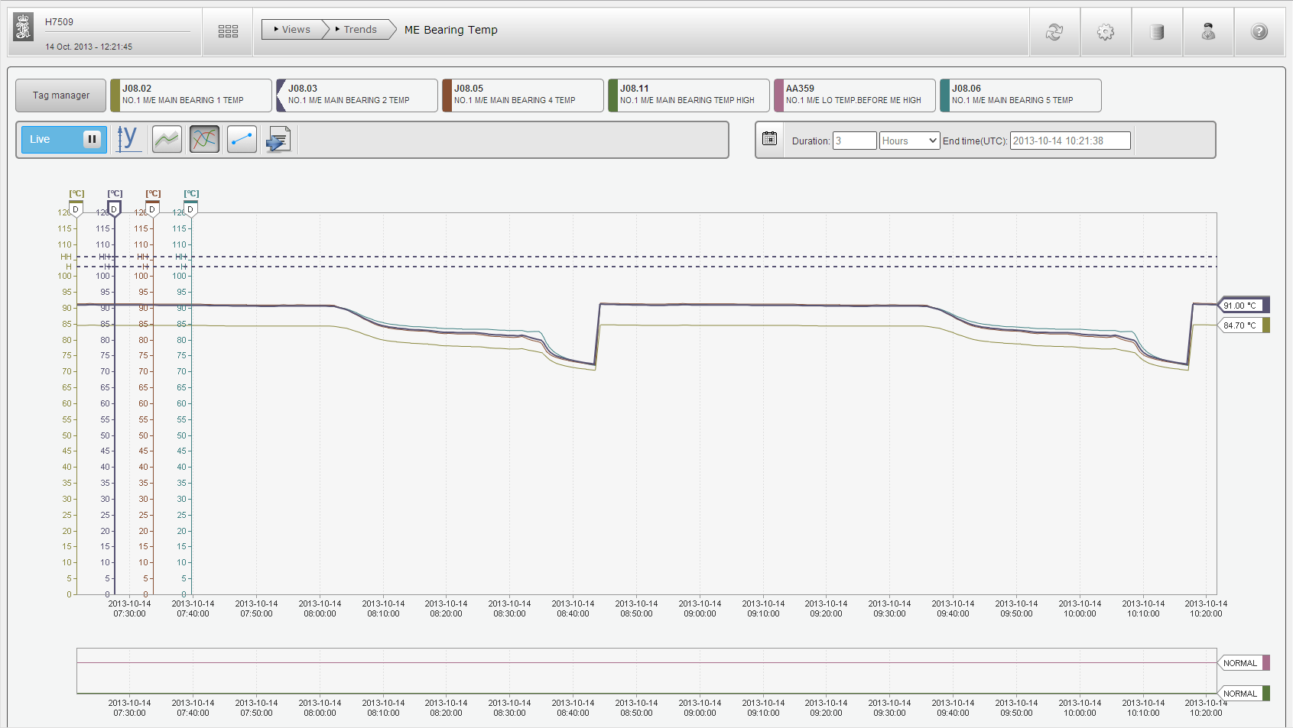
Ship@Web, a host for different applications such as:
Kongsberg Maritime
Viewer
Report Designer
Report Generator
Export
Trend

Slide 24
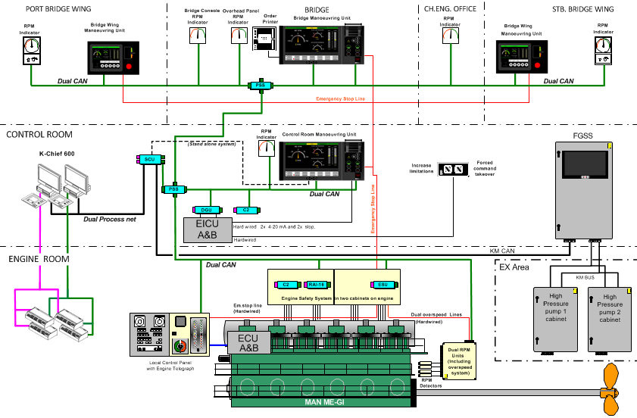
AutoChief 600 GAS - OPTIONAL
Kongsberg Maritime

Slide 25
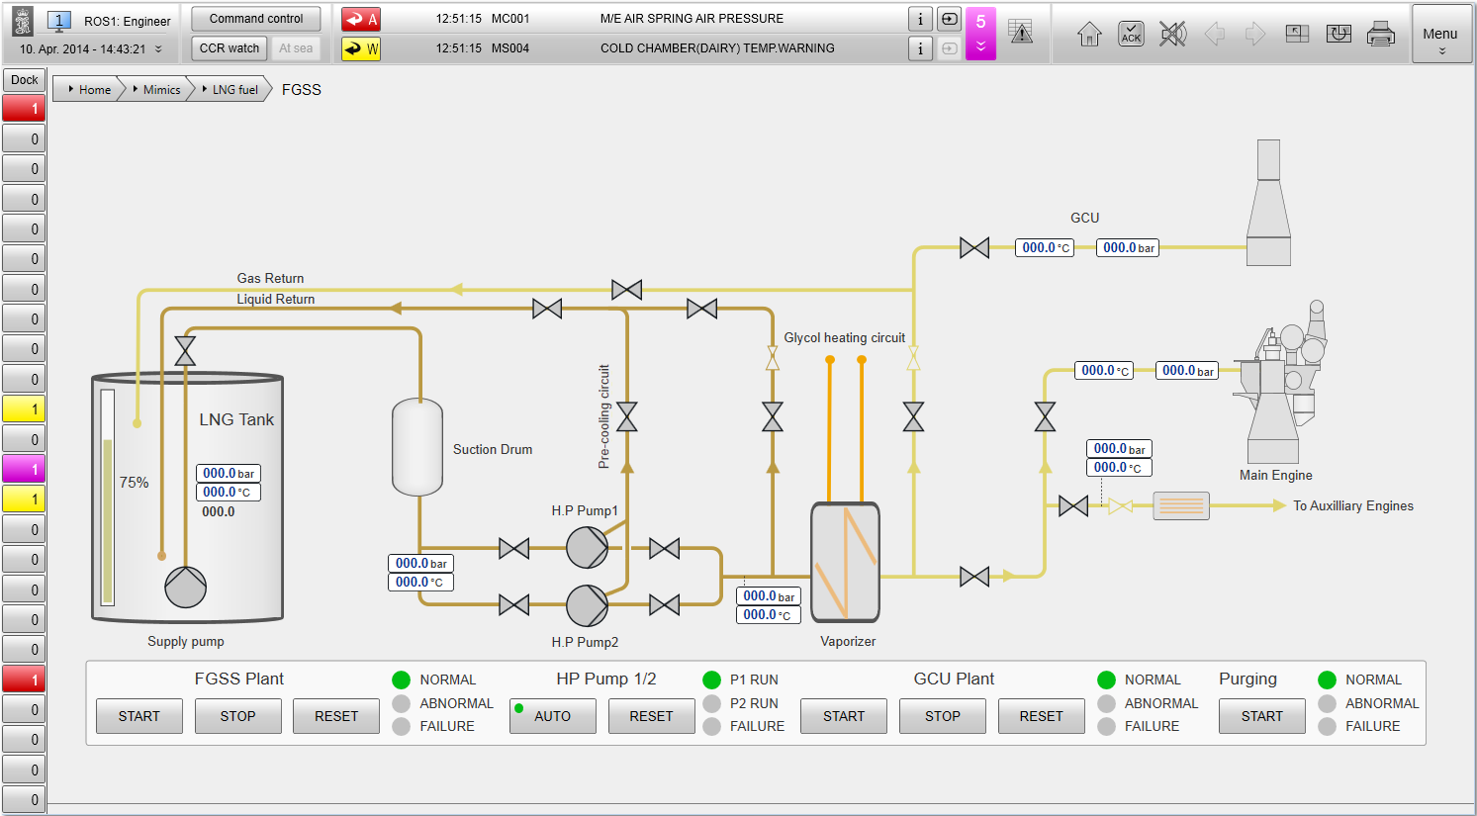
Fuel Gas Supply System, K-Chief 600 OPTIONAL
Kongsberg Maritime
This mimic diagram is made for demonstration purposes only, and will be re-designed in order to match each individual installation.

Slide 26
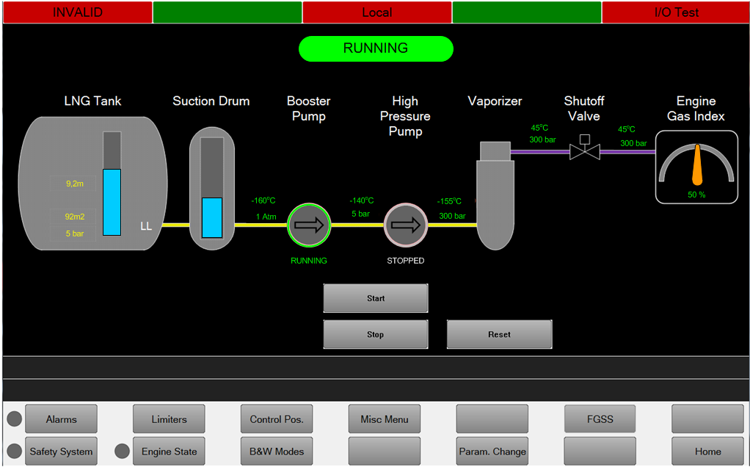
Fuel Gas Supply System, AutoChief 600 OPTIONAL
Kongsberg Maritime
This mimic diagram is made for the GasTech exhibition and may not be the final design.

Slide 27
KONGSBERG
AFTER SALES SERVICE AND SERVICE AGREEMENTS INFO

Slide 28
KONGSBERG Benefits of a Service Agreement
Spareparts handling assistance
All parts delivered by Kongsberg in the original scope of delivery are included in the SA agreement.
Dedicated Key Account Service Manager
A dedicated and exclusive Key Support Manager will be assigned within KM Customer Support Department.
Annual maintenance service
A 40 point check routine has been established in order to have a status on the systems installed. Both service costs and cost for required replacement parts may be included in the agreement.
Keeping track on obsolete parts
KM will arrange for the replacement of worn out equipment when its convenient to do so.
This will increase safety and reduce disturbance in vessel operation.
All spare part requests will be checked and confirmed correct, according original delivery, before despatch.

Slide 29
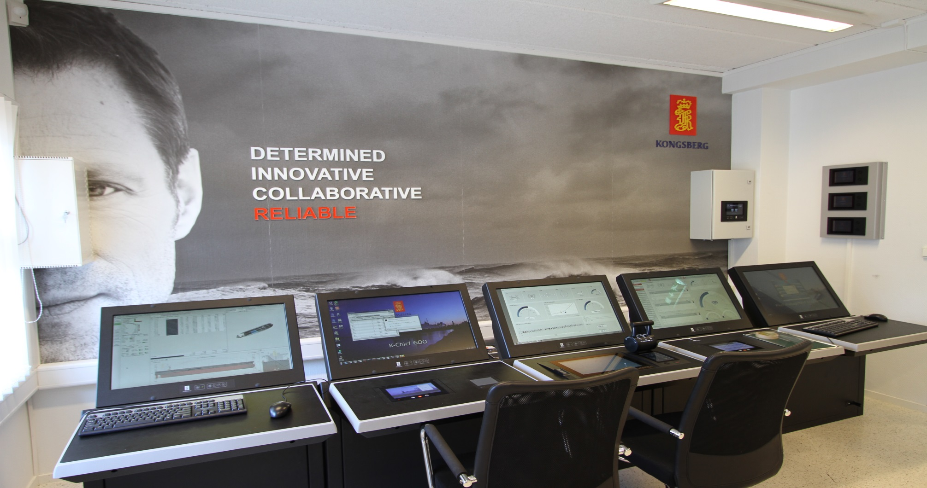
KONGSBERG Professional crew training in fully equipped training center's Norway, Greece, Dubai, Singapore, Shanghai, Busan, Houston, Rio ----

Slide 30
Thank you

Slide 31


Slide 32


Slide 33
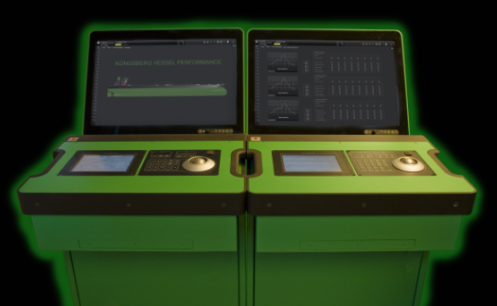


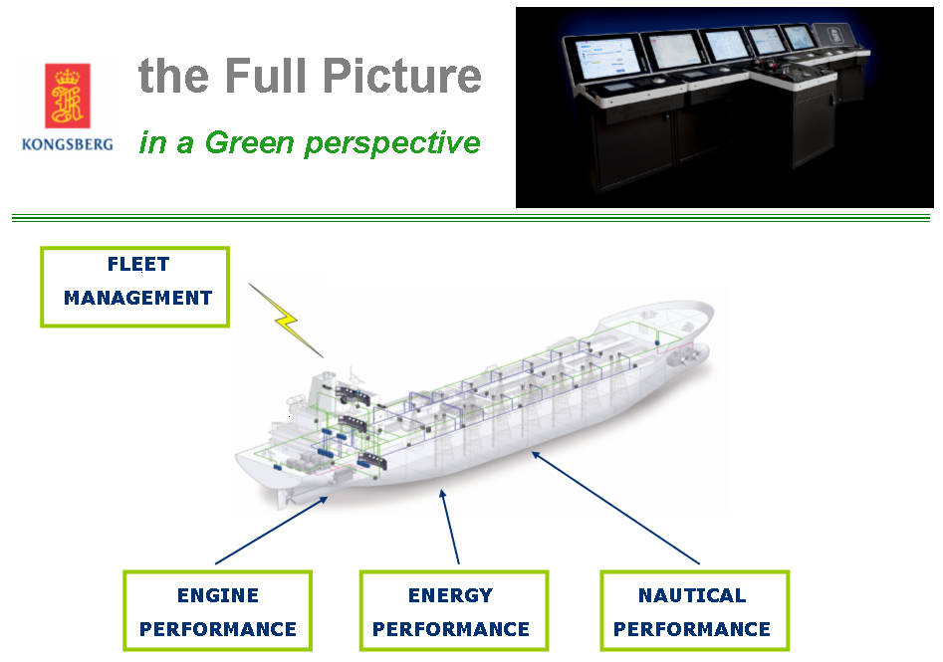
Vessel Performance

Slide 34
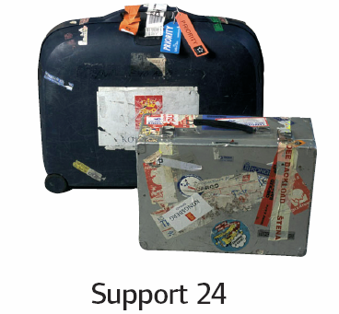
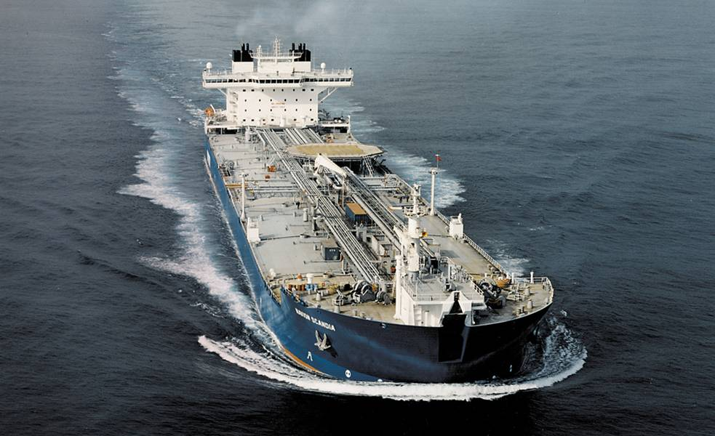
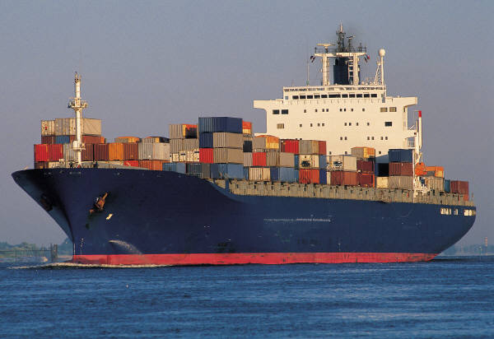
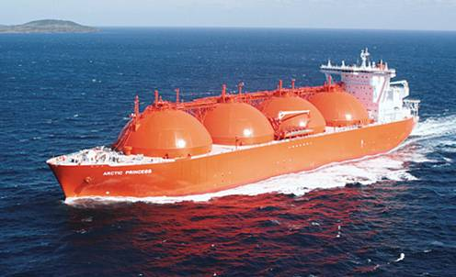
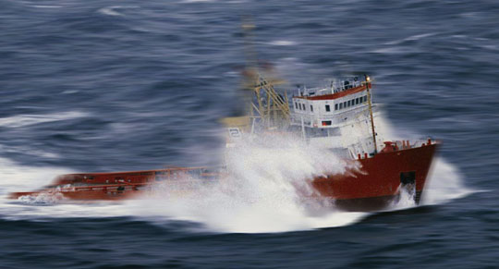

KONGSBERG Maritime 24 hours / 7 days customer support
Approx 18 000 Ships

